Slide 1
Fullstack
[Python & Django]
By Shinoop S P

Slide 2
Certifications
PCEP[Certified Entry-Level Python Programmer]
https://pythoninstitute.org/pcep
https://pythoninstitute.org/ (Active community)
Pycharm

Slide 3
Topics
Some more types in python
Python
Functional programing in python
Jango
OOP s concept in Python
Pycham
Regular Expressions in Python
Control Structure in Python
Create GUI App In Python Using Tkinter
Data types
Building Database
Functions and modules
HTML
CSS
BOOTSTRAP
Exception handling and file handling
DJANGO

Slide 4
Python
Jango
Pycharm
Interpreted High Level programing language
General purpose Programing
It support multiple Paradigm [structural, Object oriented , Functional]
Used in the area of - Web Development, Automation, Data science, Machine learning.
Jango, flask, Pyramid [frameworks of Python]
Jango used for large web application
Support so many library

Slide 5
Install python
Python.org
Install 3.6 (https://www.python.org/downloads/release/python-360/)
Windows x86-64 web based installer
Run the installed file → Must tick add path option
Use command prompt to check python ( type python then enter)
Check python version [comment prompt→ python - - version
It automatically install python default IDE [ IDLE ]
Try to print (“Hello World”)

Slide 6
Data types/operator/idle
Open IDLE Check the following
a=10
b=”welcome”
c=10.1
d=’10’
e=’20’
print(type(a))
print(b+e)
print(“nova ”*5)
print(“3”*3) (operator overloading)
a=1
a=a+1
a+=1 (place operator)
File→ new in IDLE
Type your code
Save → run

Slide 7
Install Pycharm and test a simple program
https://www.jetbrains.com/pycharm/download/#section=windows
Community → Download
Install python
File→New project
Name your project folder (nova_python_projects)--> New window
Right click on your project name→ chose python file→ name your file (first_program) (automatically create .py file)
File menu → settings →theme, Editor →font(20), project name→python interpreter (shows installed packages) + button to install packages & python structure
Type print(“Welcome”)
R.click in edit screen → run→your program name (Ctrl+shift+f10)
Comment a selected are by pressing ctrl+ / (puts # in all lines)

Slide 8
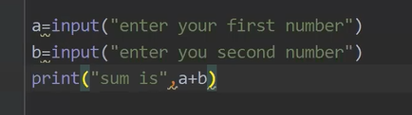
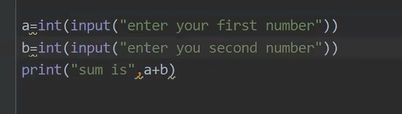
Write a simple program to add two numbers, by input two numbers from keyboard

Slide 9
Assignment
I=P x N x R calculate interest using the above equation

Slide 10
Summery
What is Python:
Python is a widely used high-level, general-purpose, interpreted,dynamic programming language Python is founded by Guido van Rossum is a Dutch programmer who is best known as the author of the Python programming language.
Mathematical operations in Python.
We can perform mathematical operations like addition, subtraction, multiplication and division in Python. We can also perform some other operations like calculating exponent of any number. For example, to calculate square of number ‘4’ we could type in 4**2 i.e 4 raised to power 2. Which is essentially calculating square of 4. In this manner we could calculate the exponent of any number. On similar terms, we could also calculate the square root of any number example 49**(1/2) which will give you the square root of number 49.
Python has five standard data types −
Numbers
String
List
Tuple
Dictionary

Slide 11
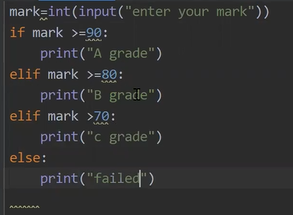
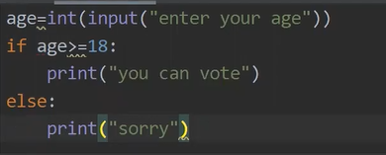
Control Structure in Python
If (eligibility of voter checking)
R.click project name→new→python file→if_program
elif

Slide 12
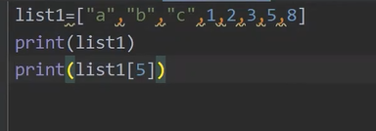
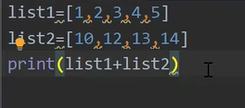

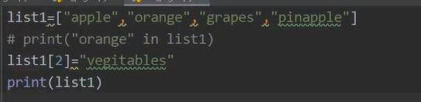
Data type
List [] (value can be any data type)

Slide 13
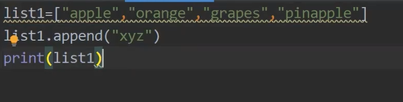
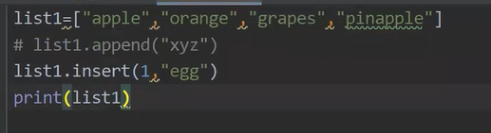
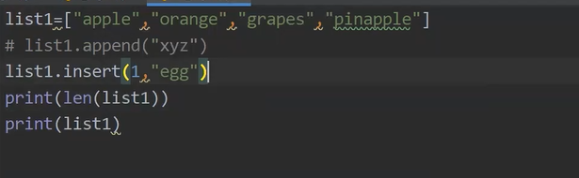
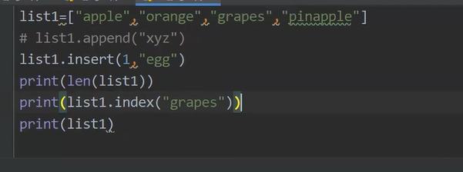
List functions
Append at last place

Slide 14
Functions and modules
A function is a block of code which only runs when it is called.
You can pass data, known as parameters, into a function.
Information can be passed into functions as arguments.
A parameter is the variable listed inside the parentheses in the function definition.
An argument is the value that is sent to the function when it is called.
A function can return data as a result.
In Python a function is defined using the def keyword:
To call a function, use the function name followed by parenthesis:
If you do not know how many arguments that will be passed into your function, add a * before the parameter name in the function definition.
To let a function return a value, use the return statement:
Python also accepts function recursion, which means a defined function can call itself.

Slide 15
Function program
Keyword Arguments
def my_function(child3, child2, child1):
print("The youngest child is " + child3)
my_function(child1 = "Emil", child2 = "Tobias", child3 = "Linus")
Function with argument
def my_function(fname):
print(fname + " Refsnes")
my_function("Emil")
my_function("Tobias")
my_function("Linus")
Creating a Function
def my_function():
print("Hello from a function")
Calling a Function
def my_function():
print("Hello from a function")
my_function()
Arbitrary Arguments, *args
def my_function(*kids):
print("The youngest child is " + kids[2])
my_function("Emil", "Tobias", "Linus")
Return Values
def my_function(x):
return 5 * x
print(my_function(3))
print(my_function(5))
print(my_function(9))
Arbitrary Keyword Arguments, **kwargs
def my_function(**kid):
print("His last name is " + kid["lname"])
my_function(fname = "Tobias", lname = "Refsnes")

Slide 16
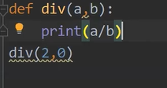
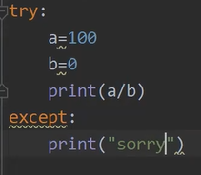
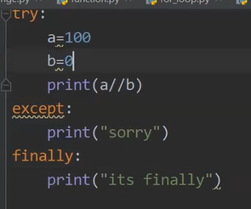

Exception handling
Package : Your project (Collection of files)
module : Your files
Import filename (can help to import a program into your program in same package
Syntax error
Logic error
Runtime error

Slide 17
file handling Read, Write, Append Operations in file (modes)
Create:
file1=open(“demo.txt”, “w”)
file1.close
Run above code automatically create a file named demo.txt
Read a Content
from the demo.txt (Change mode to read)
file1=open(“demo.txt”, “r”)
content=file1.read()
print(content)
file1.close
Write content
file2=open(“demo2.txt”, “w”)
file2.write(“Hai this is testing”)
file1.close
append Content
file3=open(“demo2.txt”, “a”)
file3.write(“added from fle3”)
file1.close

Slide 18
Dictionaries dic={}: Key and Value Concept
dic={“apple”:200,”orange”:300}
print(dic)
print(dic[“apple”])
for i in dic:
print(i)
for i in dic.values():
print(i)
for i in dic.items():
print(i)
dic={“apple”:200,”orange”:300}
dic[apple]=380
print(dic)
del dic[“apple”]
print(dic)
—

Slide 19
Dictionary Functions: get(),
price={"apple":200,"orange":300}
print(price)
print(price["apple"])
for i in price:
print(i)
for i in price.values():
print(i)
for i in price.items():
print(i)
del price["apple"]
print(price)
price["orange"]=600
print(price)
if "orange" in price:
print("available")
price["grape"]=100
print(price)
price.popitem()
print(price)
dict={
1:”abc”,
2:”xyz”,
3: “raju”
}
print(dict.get(1) )
print(dict.get(5, “key not found”) )
Changeable
Unordered
Indexed
{}
Key value relationship
newdic=dict(Name="shinoop",age=40)
print(newdic)

Slide 20
Python Lambda A lambda function is a small anonymous function.
A lambda function can take any number of arguments, but can only have one expression.
lambda arguments : expression
The expression is executed and the result is returned:
Add 10 to argument a, and return the result
x = lambda a : a + 10
print(x(5))

Slide 21
OOP s concept in Python

Slide 22
Regular Expressions in Python
Import re
Pattern= “nova”
If re.match(pattern

Slide 23
Create GUI App In Python Using Tkinter

Slide 24
Building Database

Slide 25
HTML

Slide 26
CSS

Slide 27
BOOTSTRAP

Slide 28
DJANGO
DJango is a Python Web Framework.
MVT (Model view template) Architectural
It's free and Open source
Basic part is already created (admin part, security, database etc)
You must know Python, HTML & CSS

Slide 29
Django Need the following https://www.djangoproject.com/
PYTHON (install python)
https://www.python.org/downloads/
CODE EDITOR (VS code/ PyCharm) (install VS code)
https://code.visualstudio.com/download
Create your project folder (E:/mydjangoproject/)
Drag the folder into VS code
Confirm the project folder in explorer to to terminal->new terminal
Come to extension area - install python & Django Extension
Virtual Environment
Type python -m venv djvenv in terminal
Type djvenv\scripts\activate ( for active our venture environment)
If error use this step go to system settings -> Update & Security -> For Developers -> PowerShell→apply
Django
pip install django (You must connect internet) (check djvenv/lib/django - some automatic folder and files creed in this folder)
Note: python manage.py runserver

Slide 30
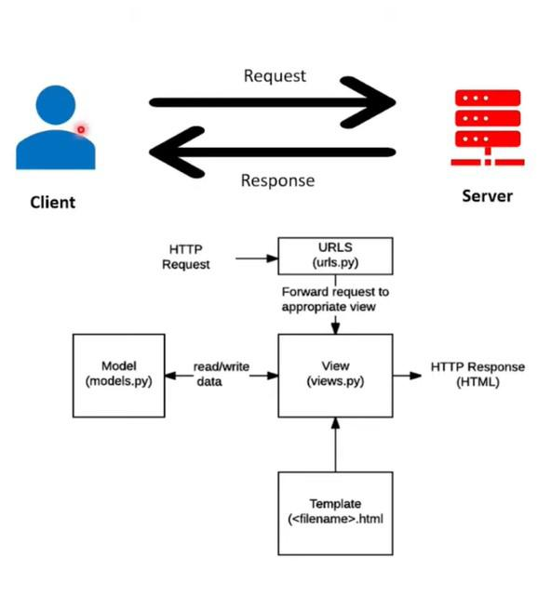
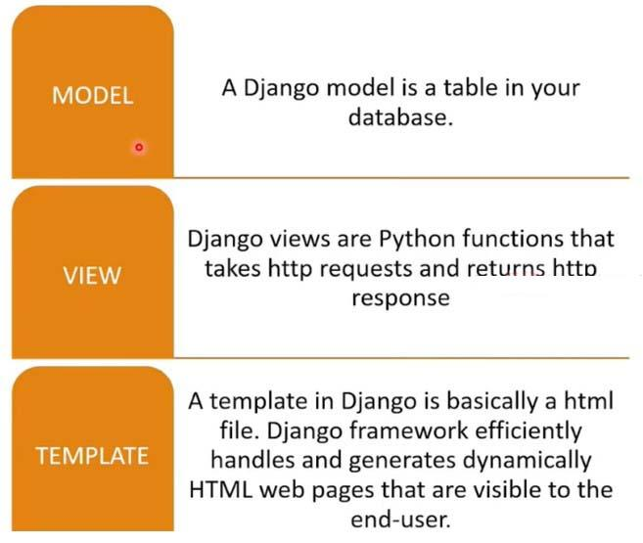
Django MVT (Software design pattern)

Slide 31
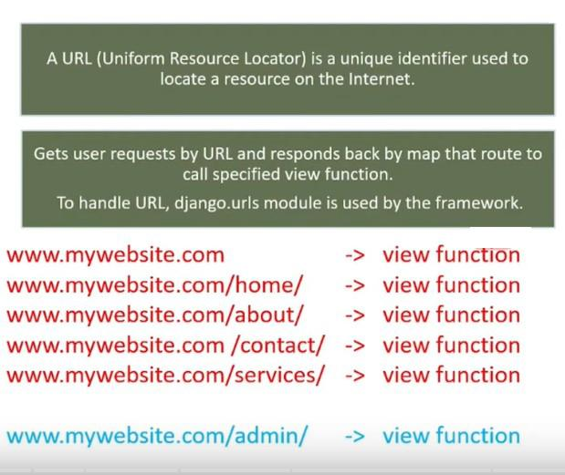
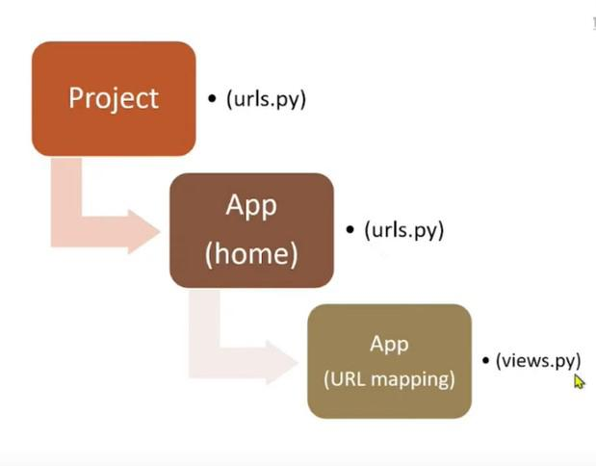
URLs & Views

Slide 32
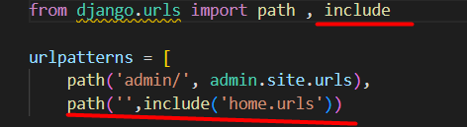
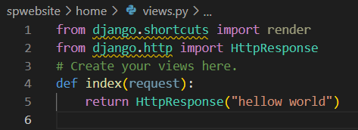
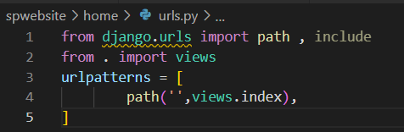
Url & Views Mapping [home]
Urls.py in home folder
Urls.py in project folder
Urls.py in home folder(if not exist create one)

Slide 33
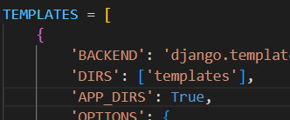
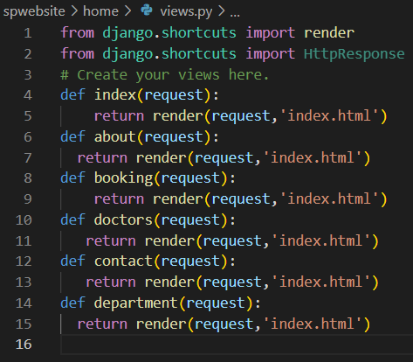
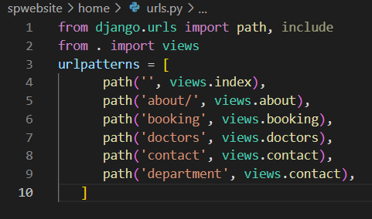
Template
Create a folder named templates in main project folder
Change views.py file for template
def index(request):
return render(request,'index.html')
In template folder create an index.html file
Install html-boilerplate extension in VS code
Type html5-boilorplate automatically create a boilser plate index content, - edit as of your need
Open settings.py - under template - add template in DIR inside
Create another pages and update contents in views.py

Slide 34
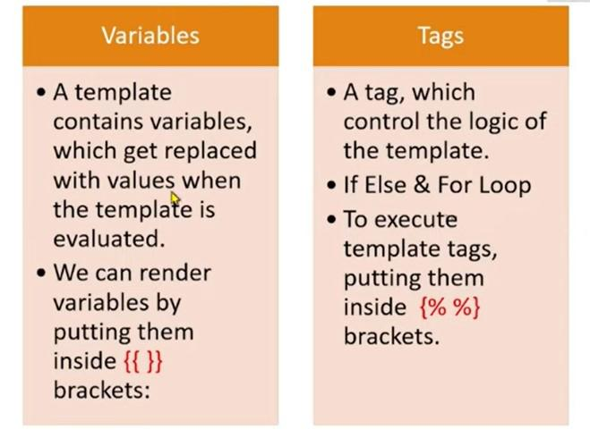
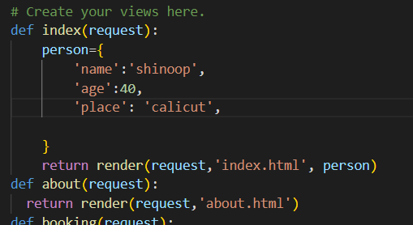
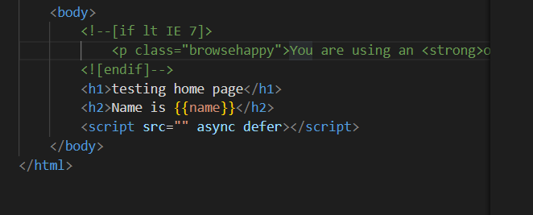
Variables and tags

Slide 35
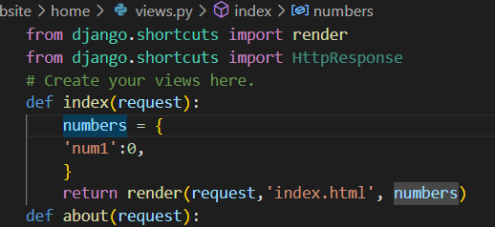
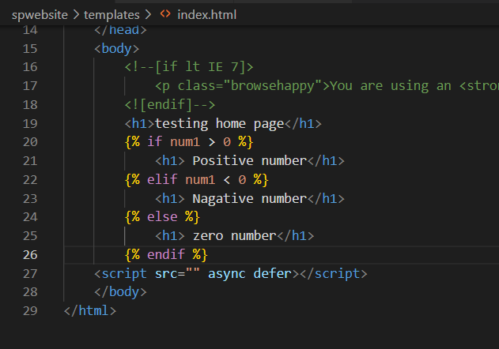
Using tag [if…]

Slide 36
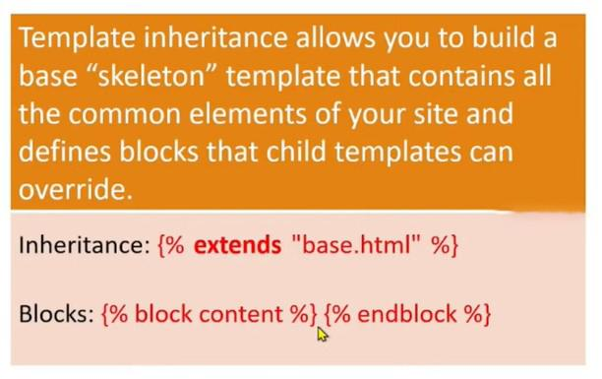
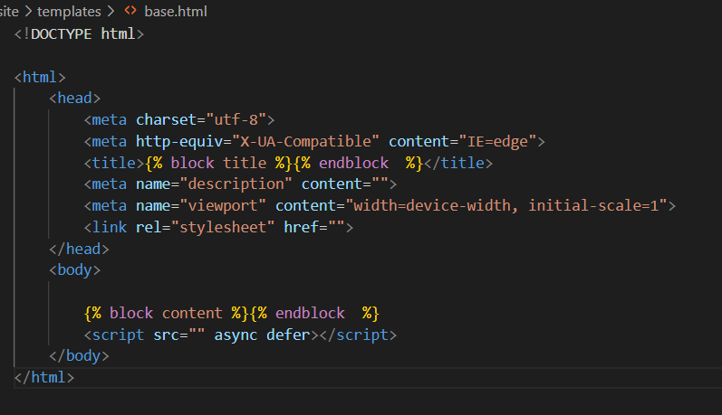
Template inheritance base.html
Create a file named base.html

Slide 37
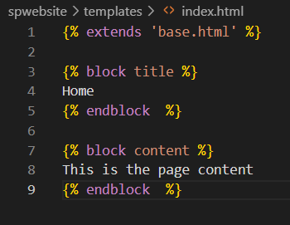
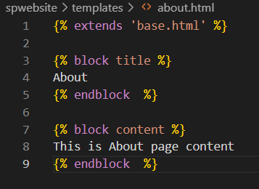
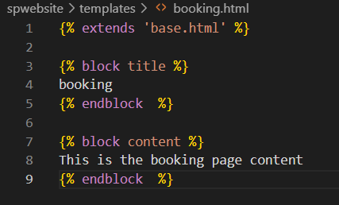
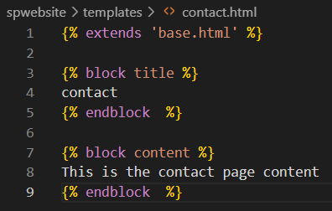
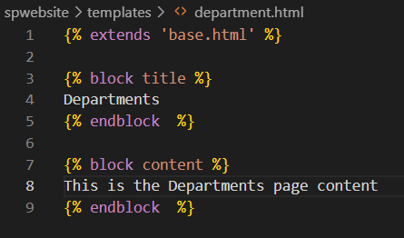
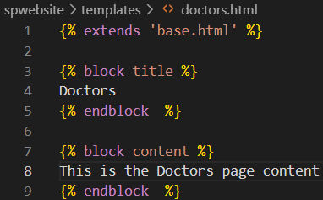
Template index.html and other pages

Slide 38
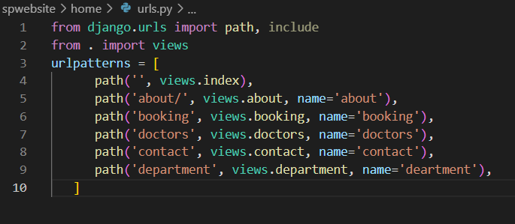
Template using bootstrap -1
Rename existing base.html to oldbase.html
Download the base.html (https://drive.google.com/drive/folders/1tGIPMmiTkmtqxbc5Wdg6BxE8pT6ooTDF)
place the existing base.html into project folder
Copy title and content blocks from oldbase.html to base.html
Come to urls.py in ‘home’ folder

Slide 39
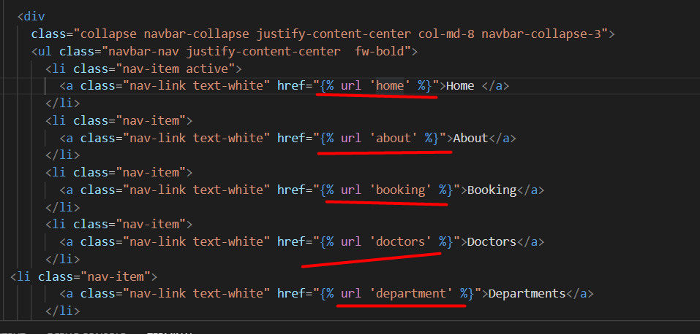
Template using bootstrap -2
6. Come to base.html edit all # links

Slide 40
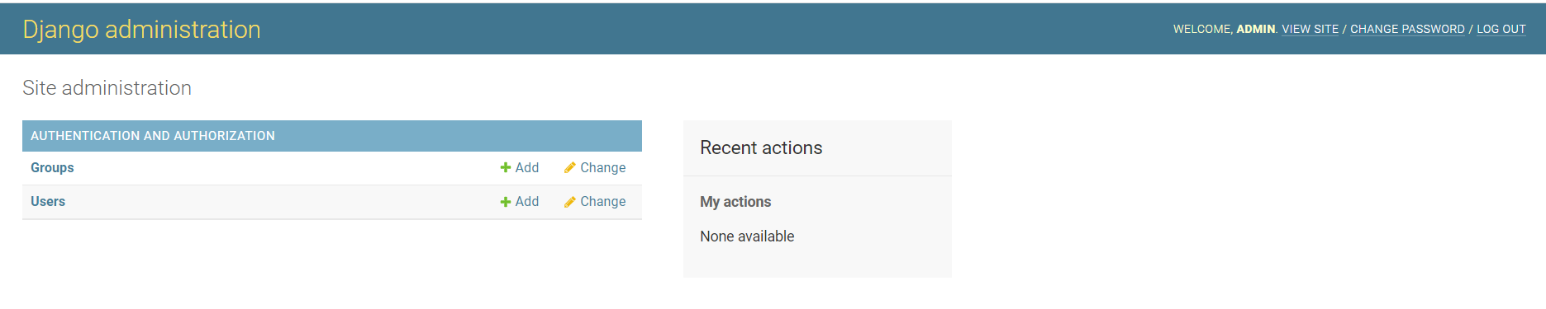
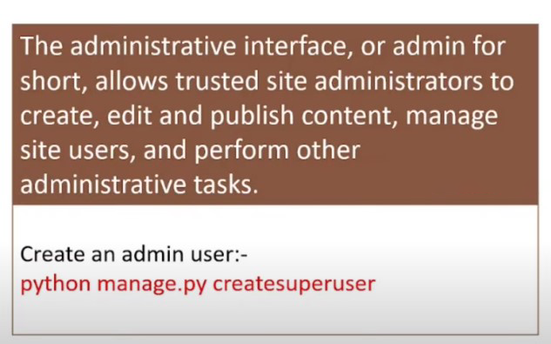
Django admin - 1
ctrl +c to close server
Python manage.py makemigrations
Python manage.py migrate
python manage.py createsuperuser
Enter your username, email, password
Admin, spshinoop@gmail.com, Admin*123
Python manage.py runserver
In browser (http://127.0.0.1:8000/admin)
Type your id and password

Slide 41
Django admin - 2
Add user (reception, Userreception*123) → save and continue
Firstname (reception, Activate, staff status, Save, logout
Login again→ login using– reception, Userreception*123 (No editing permission) so logout
Login again as superadmin
Now delete the reception user and logout

Slide 42
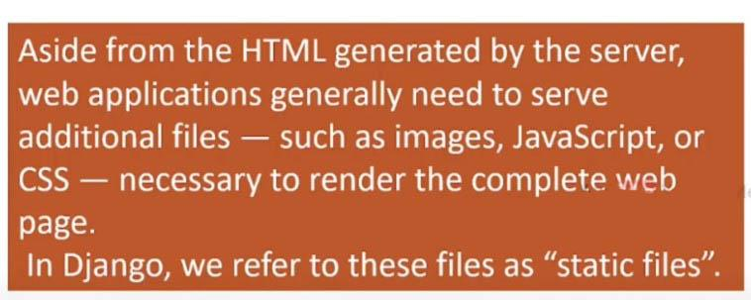
Django Static files

